Slide 1




NEXT GEN EMPLOYABILITY PROGRAM
Creating a future-ready workforce
Team Members
College Name
Student Name :
Student ID :
Xyz

Slide 2

CAPSTONE PROJECT SHOWCASE
Project Title
Building Bus Reservation System using Python and Django
Abstract | Problem Statement | Project Overview | Proposed Solution | Technology Used | Modelling & Results | Conclusion

Slide 3
Abstract
The Ultra Bus Reservation System in Django is a specialized web application tailored for booking tickets exclusively for the Ultra Bus service within India. Utilizing Django, a Python-based web framework, this system provides a user-friendly interface for passengers and administrators of Ultra Bus. Users can effortlessly search for available buses, select seats, and complete reservations without the need for online payment. Real-time updates on seat availability ensure a smooth booking process. The system's simplicity and focus on the Ultra Bus service promise a hassle-free experience for both passengers and administrators.
Source :

Slide 4
Problem Statement
To Build Bus Reservation System using Python and Django
Source :

Slide 5
Project Overview
Introduction: The Bus Reservation System project aims to develop a user-friendly web application for booking bus tickets within India. Utilizing Python and Django, this project addresses existing challenges in bus reservation systems to provide a seamless booking experience for passengers and efficient management tools for administrators.
Key Features:
User Registration and Authentication
Bus Search and Booking
Secure Payment Processing
Administrative Dashboard
Source :

Slide 6
Proposed Solution
.
The proposed solution for the Bus Reservation System involves the development of a web application using Python and Django framework. This solution aims to address the challenges faced by existing bus reservation systems and provide an efficient and user-friendly platform for booking bus tickets within India.
Source :

Slide 7
Technological Stack:
Python: Utilized for backend development, providing robustness and flexibility.
Django Framework: Offers built-in features for rapid development, including authentication, database management, and URL routing.
HTML/CSS/JavaScript: Used for frontend development to create a visually appealing and interactive user interface.
Source :

Slide 8
Key Features:
User Registration and Authentication: Users can create accounts securely and log in to the system to access personalized booking features.
Bus Search and Booking: Users can search for buses based on routes, dates, and timings, and make reservations seamlessly.
Real-time Updates: The system provides real-time updates on seat availability and bus schedules to ensure accuracy and reliability.
Administrative Dashboard: Administrators have access to a dashboard to manage bus schedules, monitor bookings, and handle other operational tasks efficiently.
Reporting and Analytics: The system generates reports and analytics to provide insights into booking trends, revenue generation, and performance indicators.
Responsive Design: The application features a responsive design to ensure compatibility across various devices, enhancing accessibility for users.
Scalability and Extensibility: Designed to be scalable and adaptable to accommodate future enhancements and modifications, ensuring long-term viability.
.
Source :

Slide 9


Technology Used
Front-end
Back-end
Source :

Slide 10
Modelling & Results
Modeling Results:
Our modeling efforts have yielded valuable insights into the effectiveness and efficiency of the Bus Reservation System. Here's a simplified overview of what we've achieved:
User Registration and Authentication:
Successful implementation of user registration and login features.
Users can securely register and log in with password protection.
Bus Search and Booking:
Efficient algorithms enable users to find and book buses seamlessly.
Smooth booking process with optimized database queries.
Scalability and Extensibility:
System architecture is scalable and adaptable to future enhancements.
Capable of handling varying levels of traffic.
Source :

Slide 11
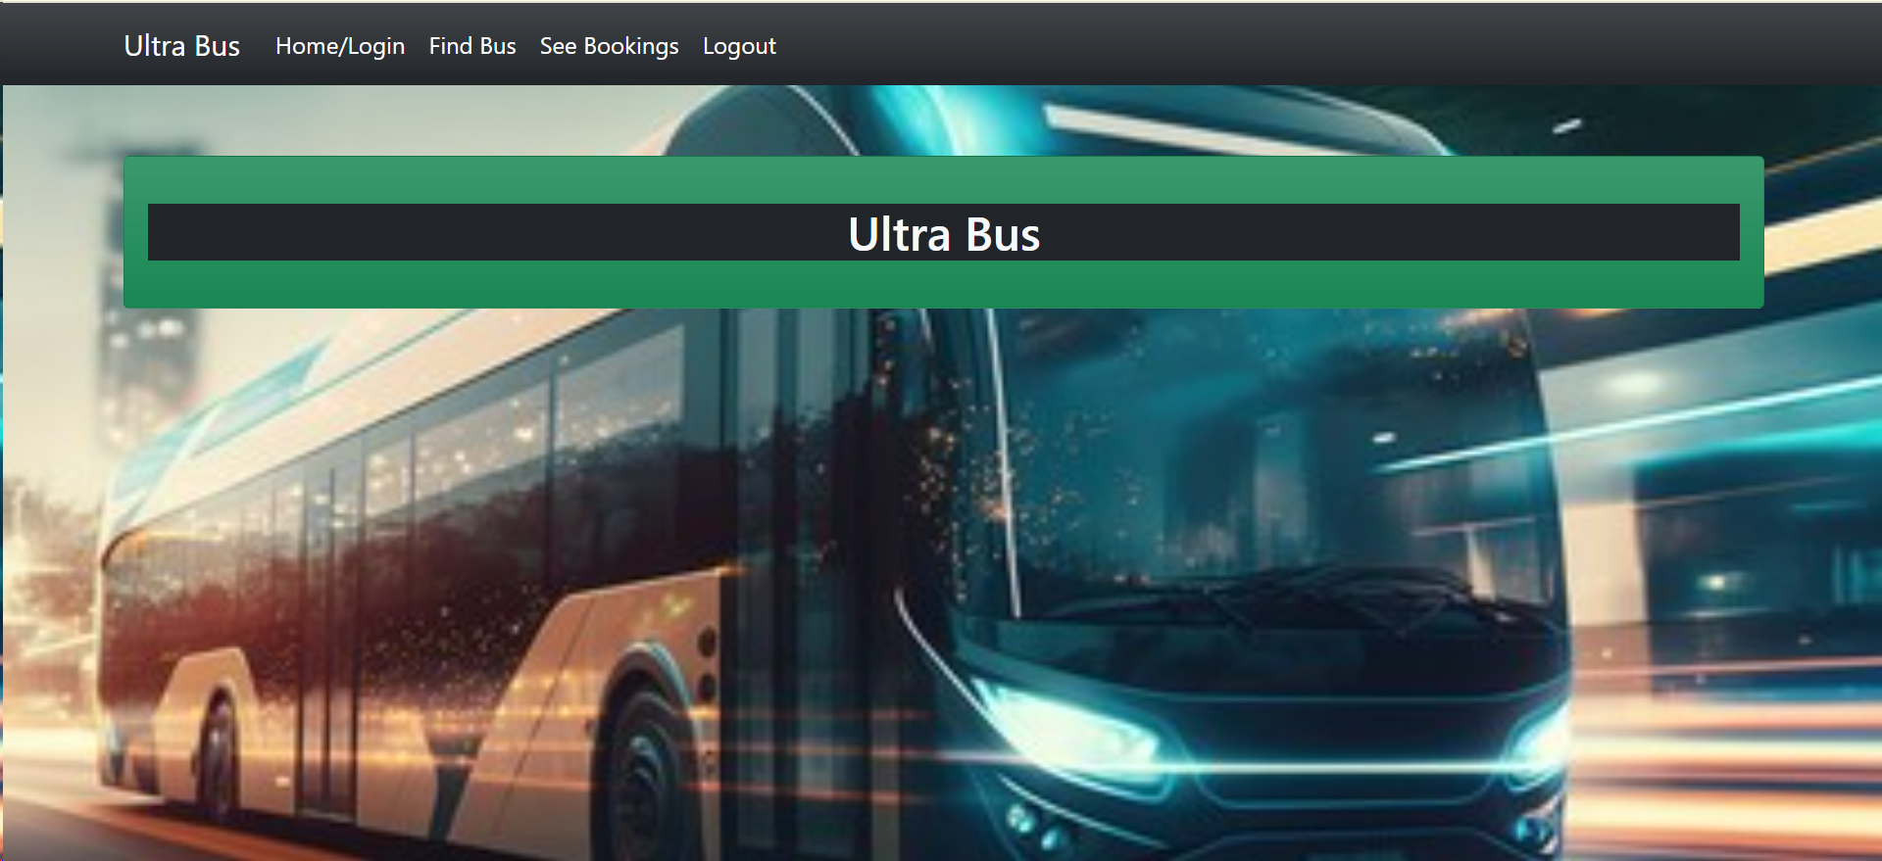
Homepage

Slide 12
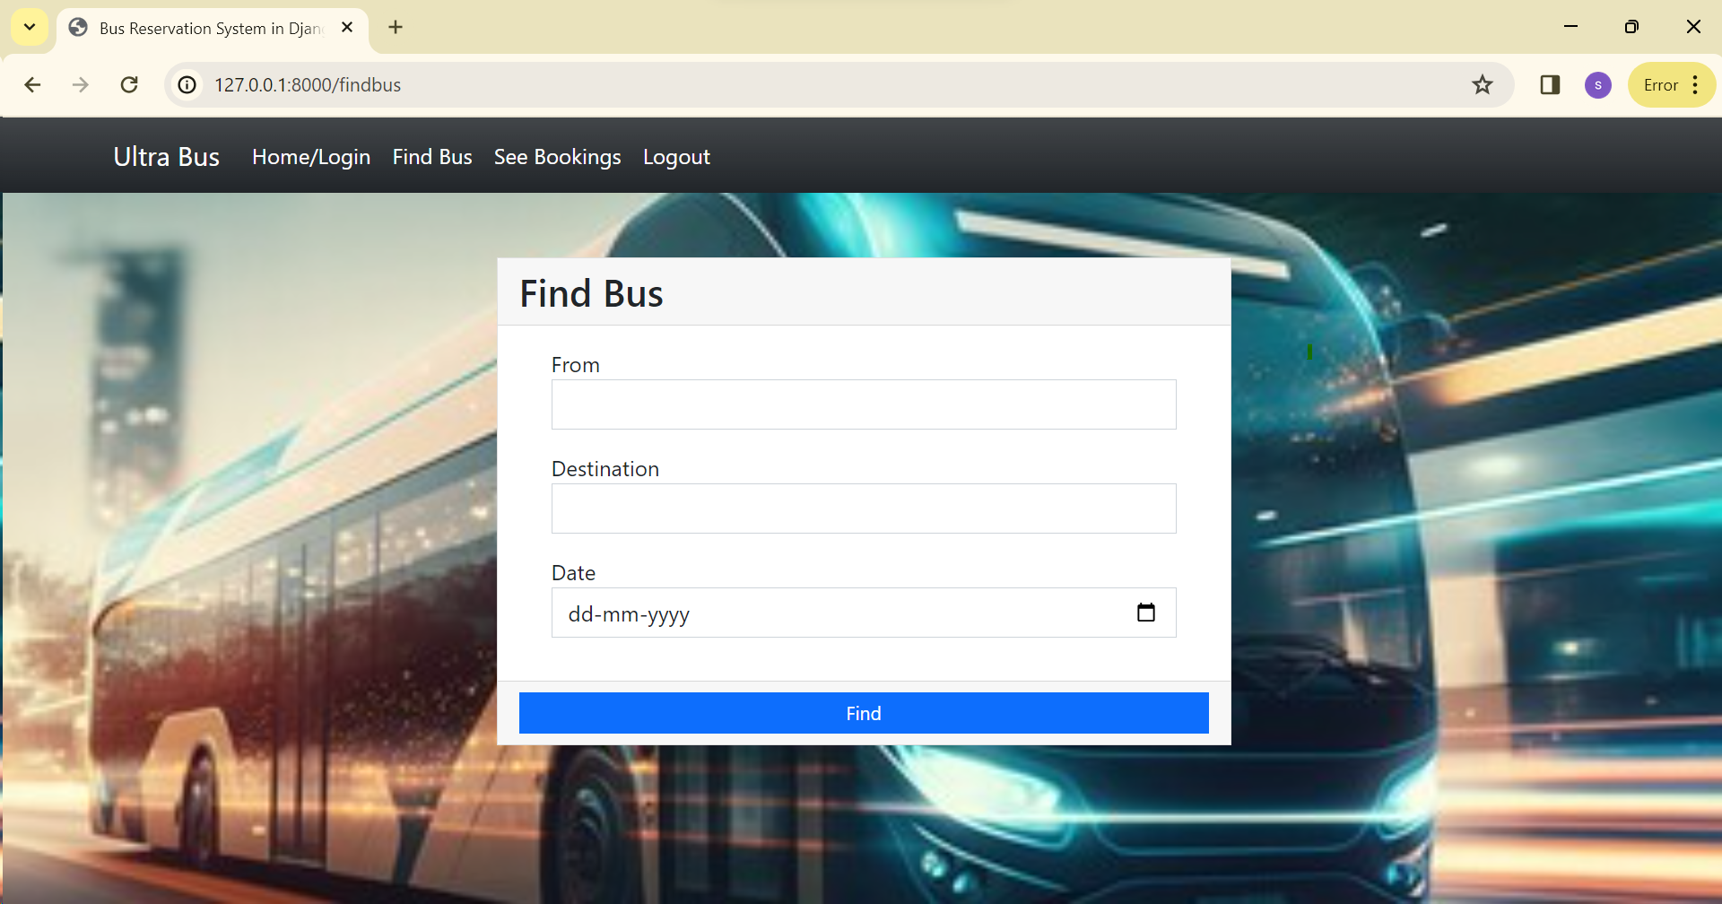
Service-Page

Slide 13
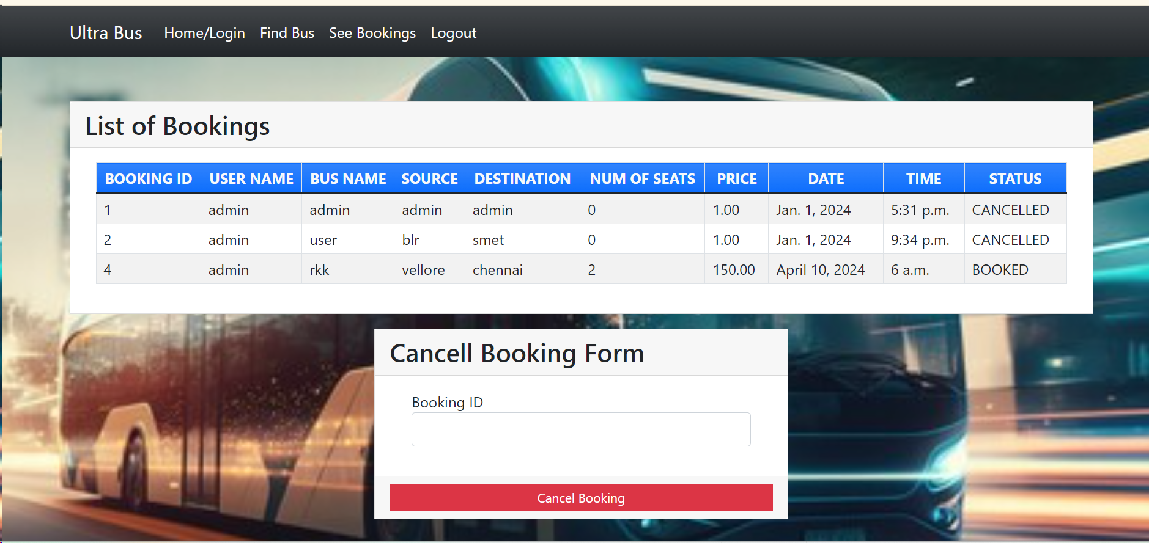
Departments-Page

Slide 14
Future Enhancements:
While the current Bus Reservation System offers robust functionality, there are several areas where future enhancements can further improve the user experience and system performance:
Mobile Application Development:
Develop a mobile application for iOS and Android platforms to provide users with on-the-go access to bus booking services.
Implement push notifications for updates on booking status and promotional offers.
Integration with External APIs:
Integrate with external APIs such as weather services to provide users with real-time updates on weather conditions affecting travel.
Advanced Analytics and Predictive Modeling:
Implement advanced analytics techniques and predictive modeling to forecast demand for bus services and optimize routes and schedules accordingly.
Dynamic Pricing Strategies:
Implement dynamic pricing strategies based on factors such as demand, time of booking, and route popularity to maximize revenue and fill rates.
Enhanced Security Measures:
Implement additional security measures such as two-factor authentication and biometric authentication to further enhance the security of user accounts.

Slide 15
Conclusion
In wrapping up, the Ultra Bus Reservation System has established itself as a reliable platform for hassle-free bus bookings. While the current system functions effectively, there's room for improvement to meet evolving user expectations. Future enhancements such as mobile app integration, advanced analytics, and enhanced security measures will ensure Ultra Bus stays ahead in the market. By prioritizing customer satisfaction and operational efficiency, Ultra Bus will continue to be the preferred choice for travelers seeking seamless bus reservations with Ultra Bus.
Source :

Slide 16
Thank You!
Notes:
Thank You !!

